Slide 1
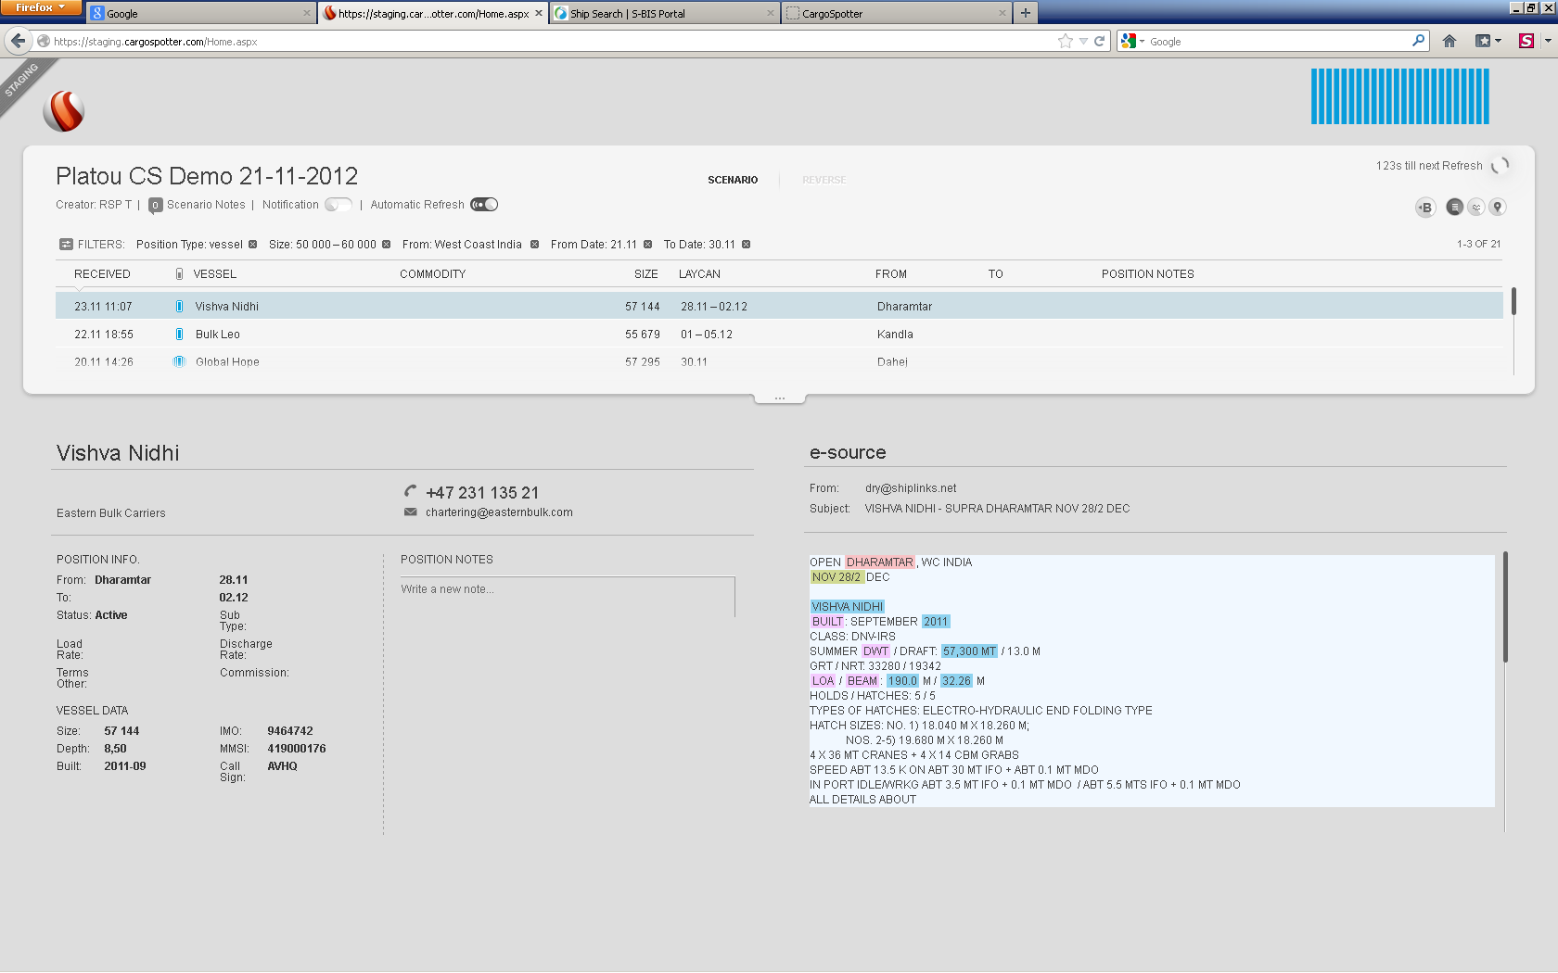
CargoSpotter want to achieve this layout

Slide 2
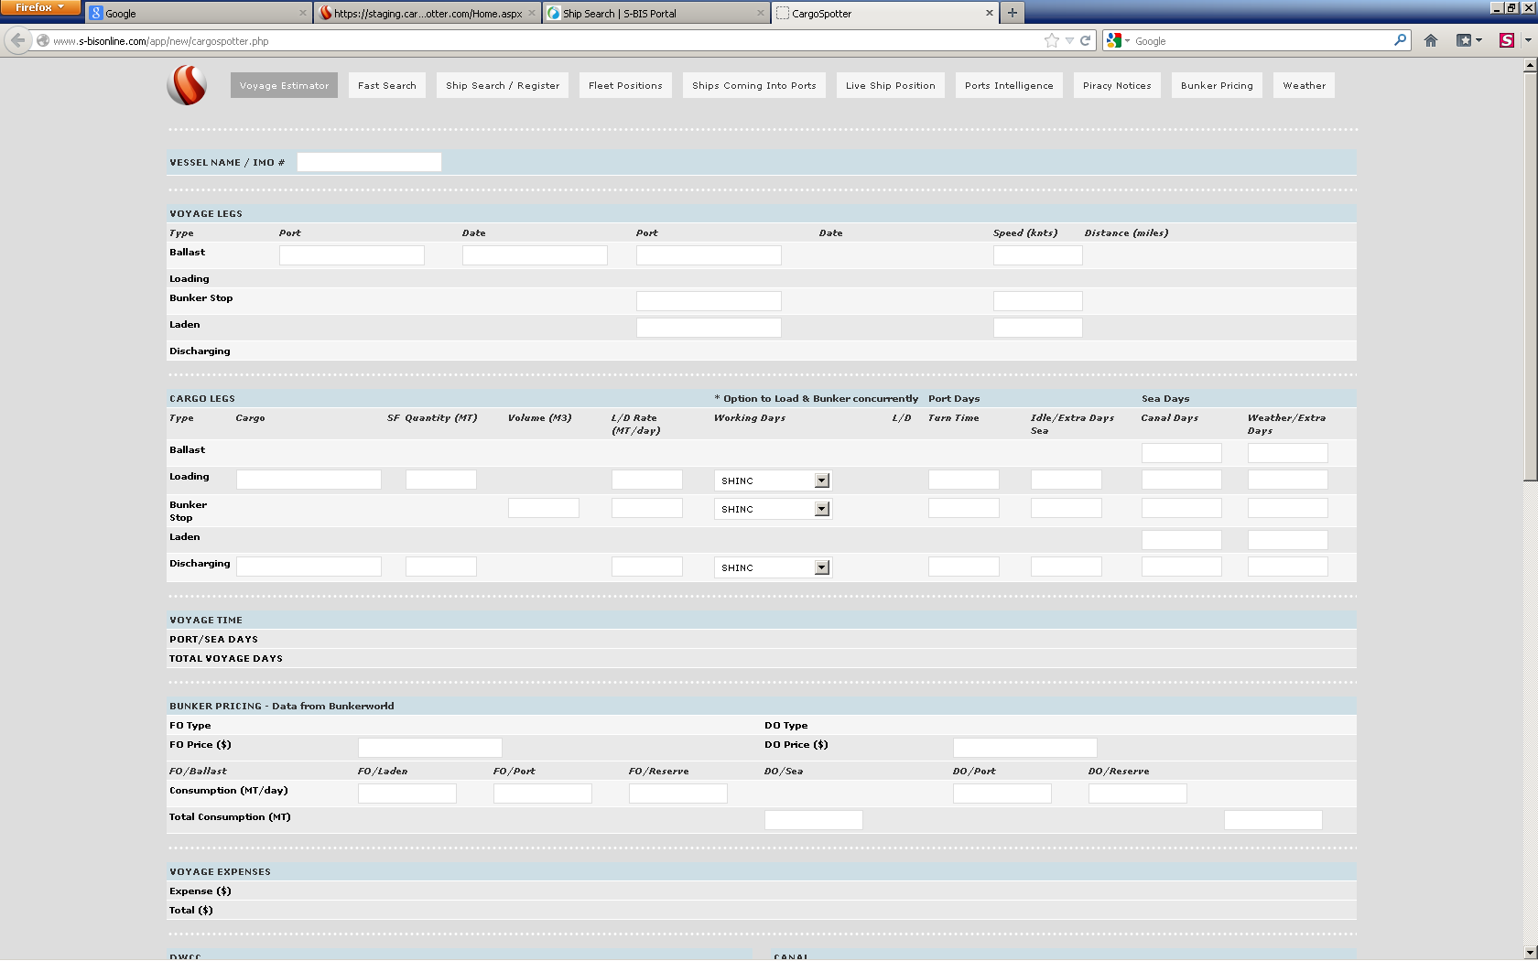

CargoSpotter Tools add in
Tools

Slide 3
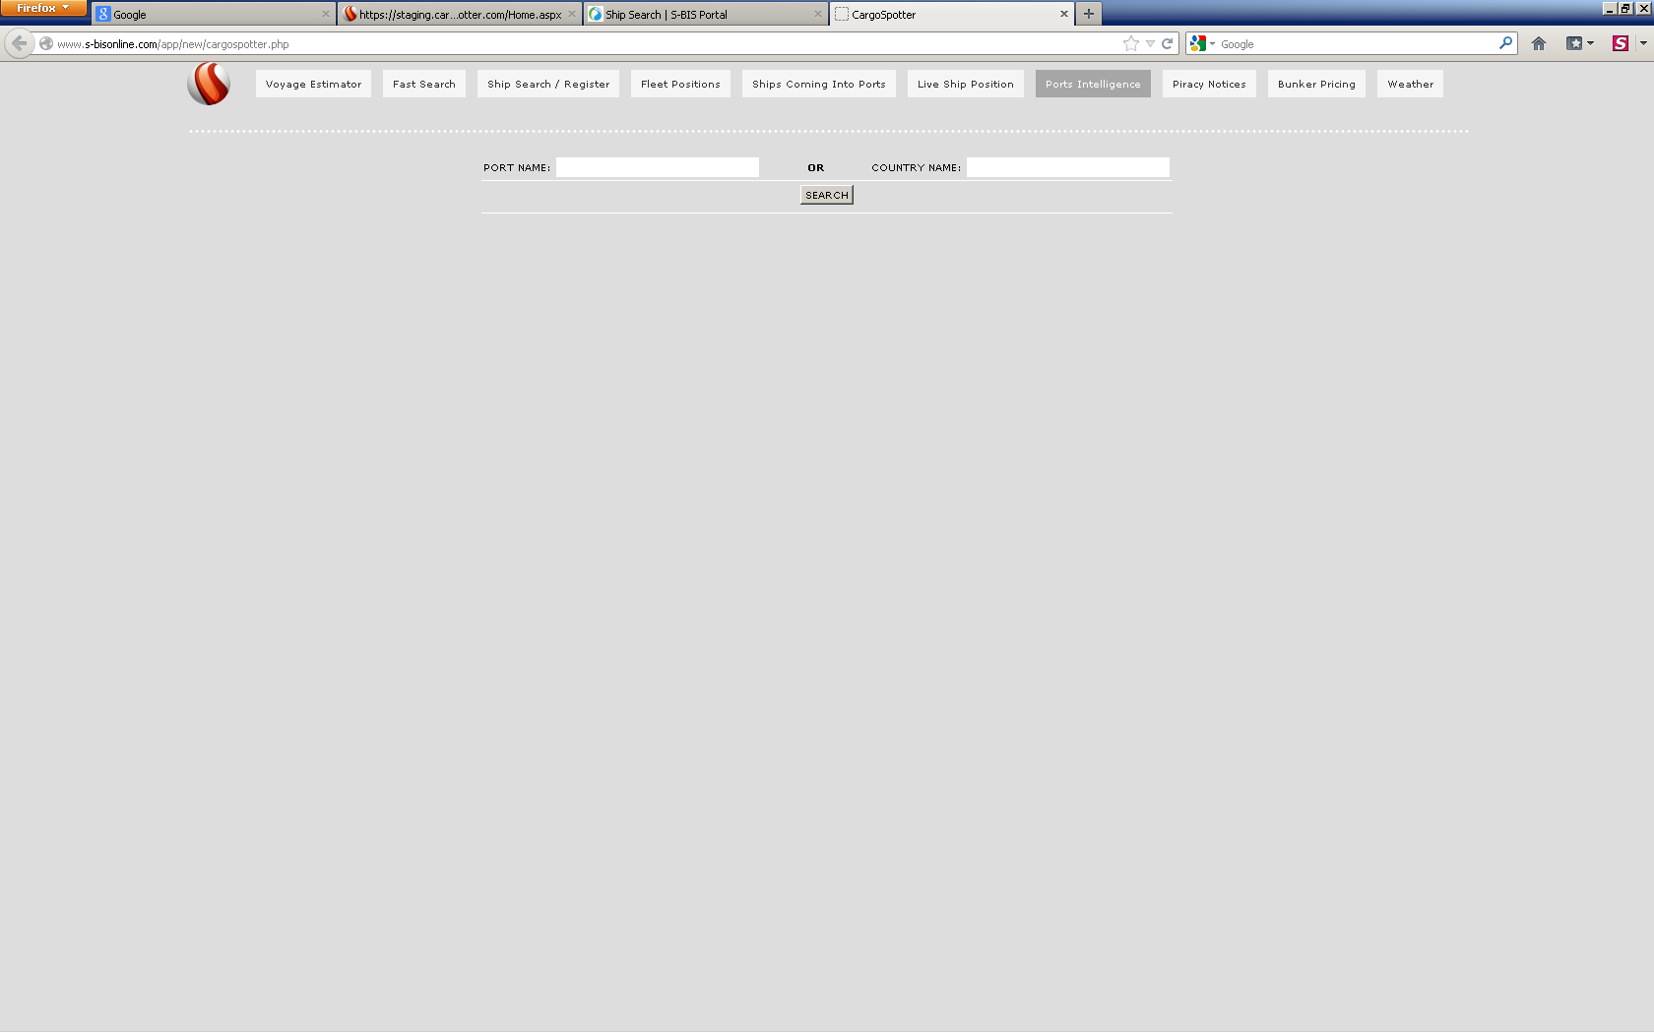
Ports Intelligence
Tools

Slide 4
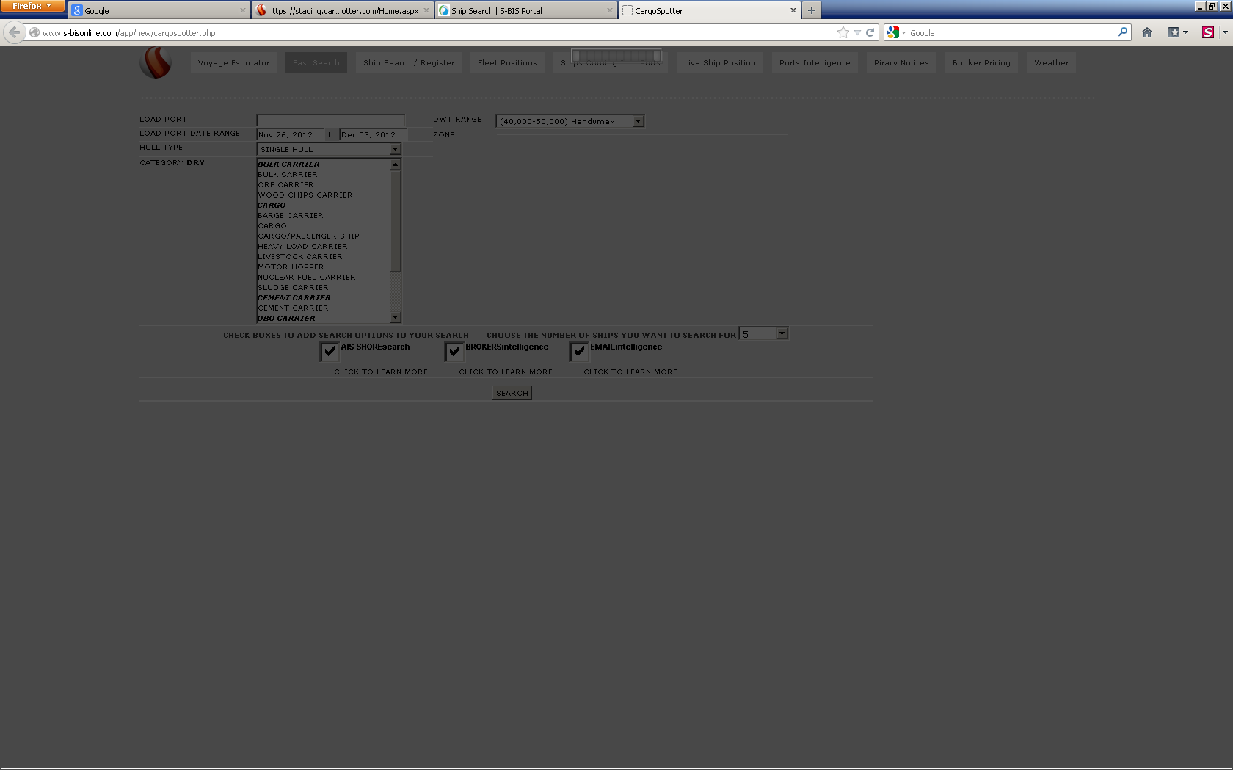
Same layout for all
Tools

